Slide 1
HPGe Coolant Monitoring System
Continuously Monitoring Reactor Coolant
David Perkins
EPRI
Technical Executive, Senior
Mirion User Group,
September 2021

Slide 2
SMART Chemistry and Online Gamma Spectroscopy
Fingerprint logic
Monitoring
Data Analysis
SMART Chemistry
Comprehensive monitoring and diagnosis
Data historian
Gamma
CZT
HPGe
Benchtop
Manual or grab sample optimization
Can we predict or how can we apply Risk Informed decisions
Digital twin or real time capabilities

Slide 3
Inline Coolant Isotopic Gamma Monitoring
The Why?
Requirements
Staff Burden
Analytics
Offsite Dose Calculation Manual
Technical Specifications
Fuel Reliability
Analysis frequency ranges from hourly – several days
Labor intensive (E-Bar, decay counts and so on)
Data transfer and evaluation
Reporting
Advanced diagnostics
Multiple samples to meet requirements
  Direct and decayed counting,
  Power suppression testing support (contractors and staff)
Staff resources
  Current process requires collection of samples, sample preparation, sample counting, manual data analyses
  24/7 availability and staffing
  How to automate or streamline
Data analyses
  The ability to collect and evaluate data compared to plant conditions
  Can we model behaviors
  Reporting - Technical Specifications

Slide 4
Gamma Spectrometry Systems
CZT Based

Slide 5
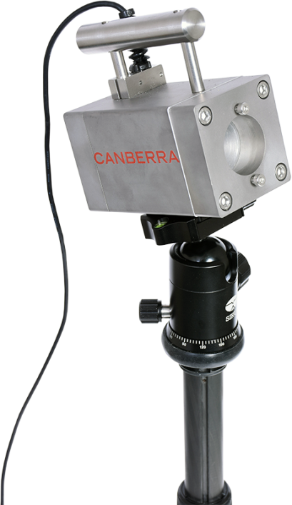
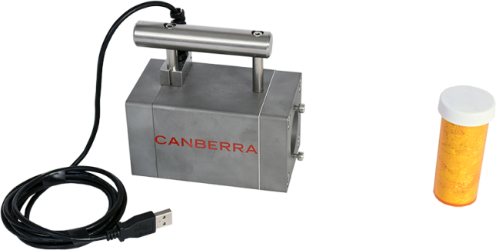
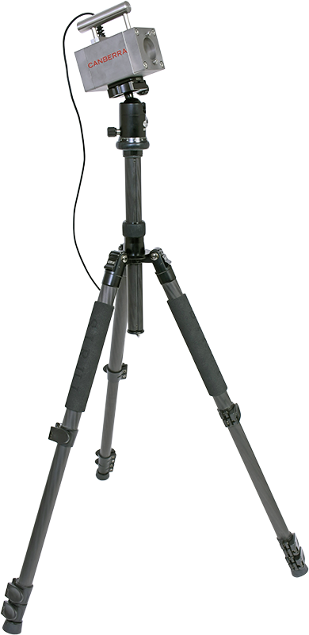
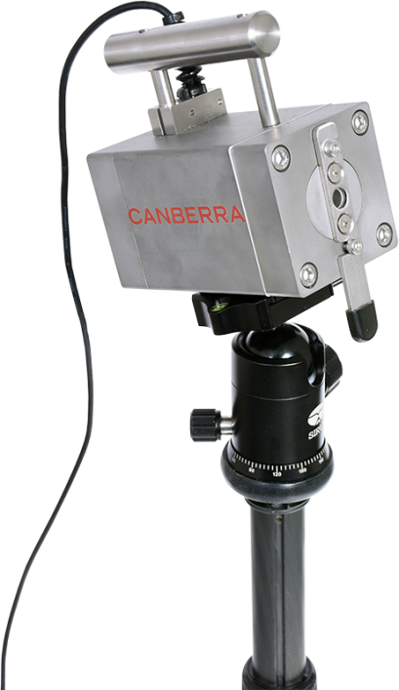
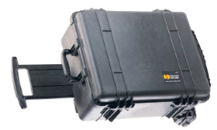
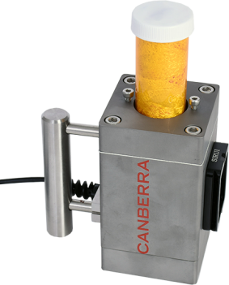
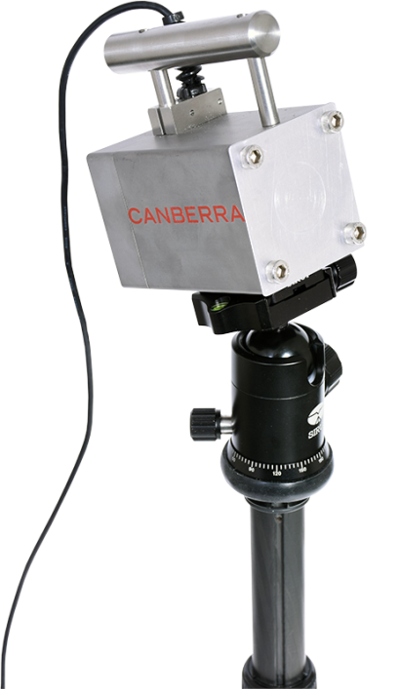
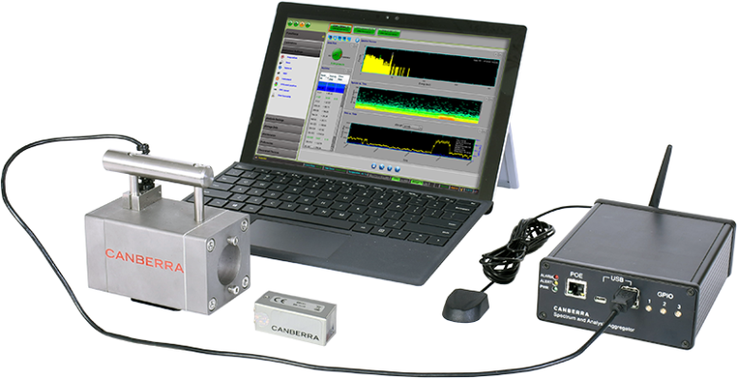
Real-time Isotopic Gamma Monitoring
Example Collimator Configurations
EcoGamma Dose Rate Meter
Collects associated local dose rates
Links to Data Analyst
Field Assay Kit
Detector, Laptop (PC), Multichannel Analyzer (MCA), Software, and Detector
MCA is internal with detector unit
PC not needed for operation
Tripod can be used for stationary monitoring
Total equipment weight ~ 30-40 lbs, clean/stable AC power desired, if not feasible UPS would be recommended
Notes:
The most convenient power arrangement is to run a single Ethernet cable from the tripod area out to an area with easy human access and AC power. The tech can then plug the PC in whenever data is desired to be viewed and downloaded. But the PC is not needed other than for setup and to view data – the device is autonomous.
Note: for short runs, a battery can be used.

Slide 6
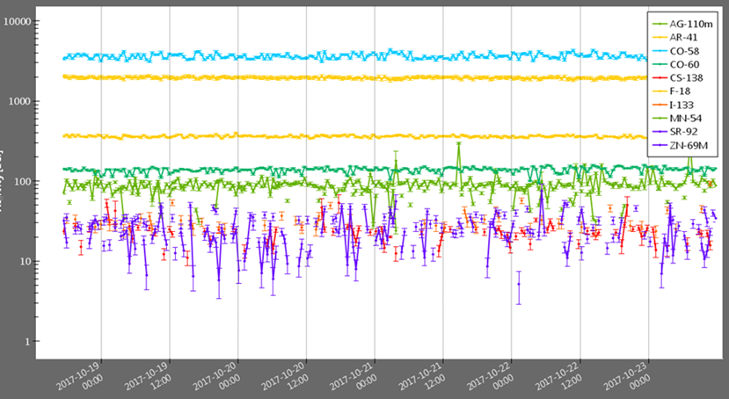
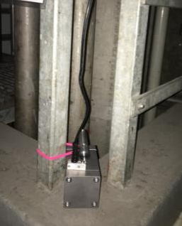
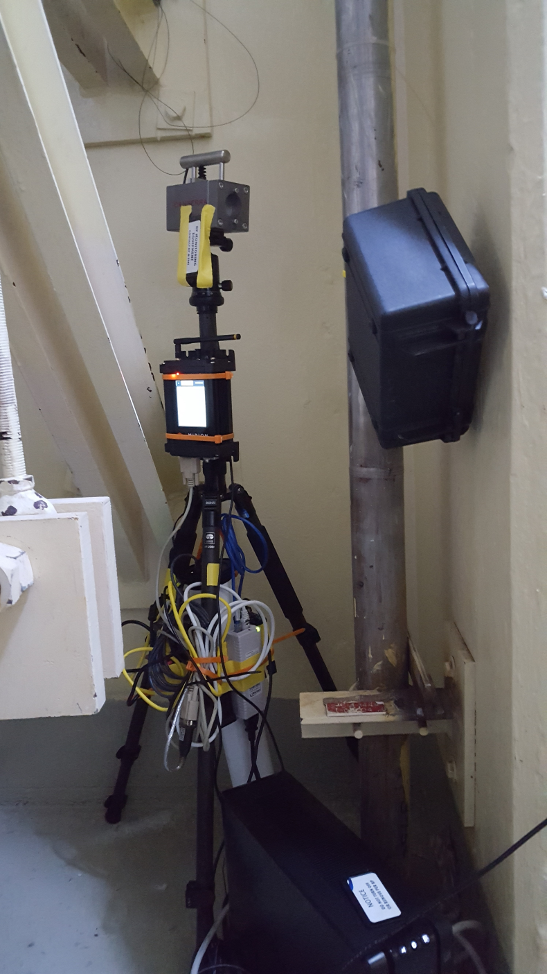
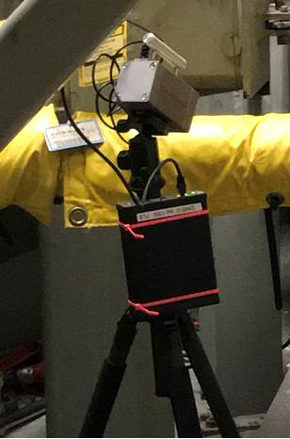
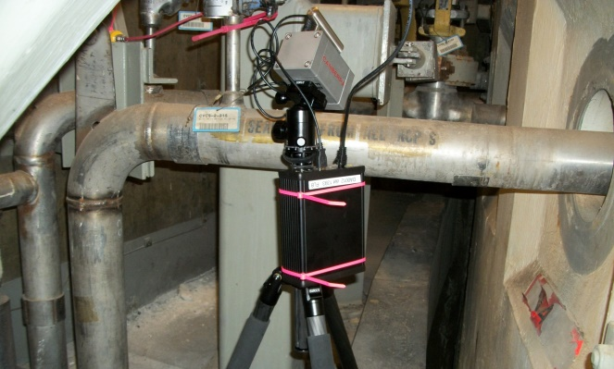
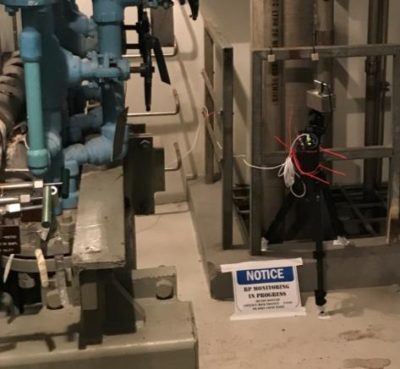
Radiation Field Real-time Isotopic Gamma Monitoring Demo
Diablo Canyon and Oconee
Letdown Line
CZT
Mirion Wireless transmitter
EcoGamma
dose rate meter
Data Analyst
Ethernet hub and POE injector
UPS unit
Diablo Canyon
Oconee

Slide 7
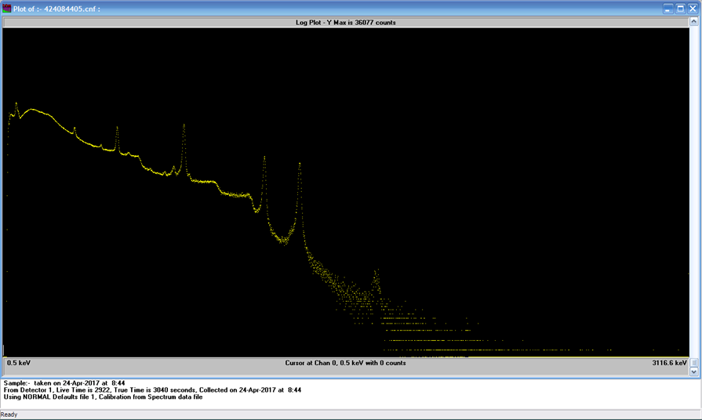
Example: Radiation Field Gamma Spectrum at Start of Forced Oxygenation
Cr-51
511 keV
Co-58
Zn-69m
Sb-124
Mn-54
Co-60
Sb-122
Co-58
Sb-124
Zr/Nb-95
Ag-110m
Fe-59

Slide 8
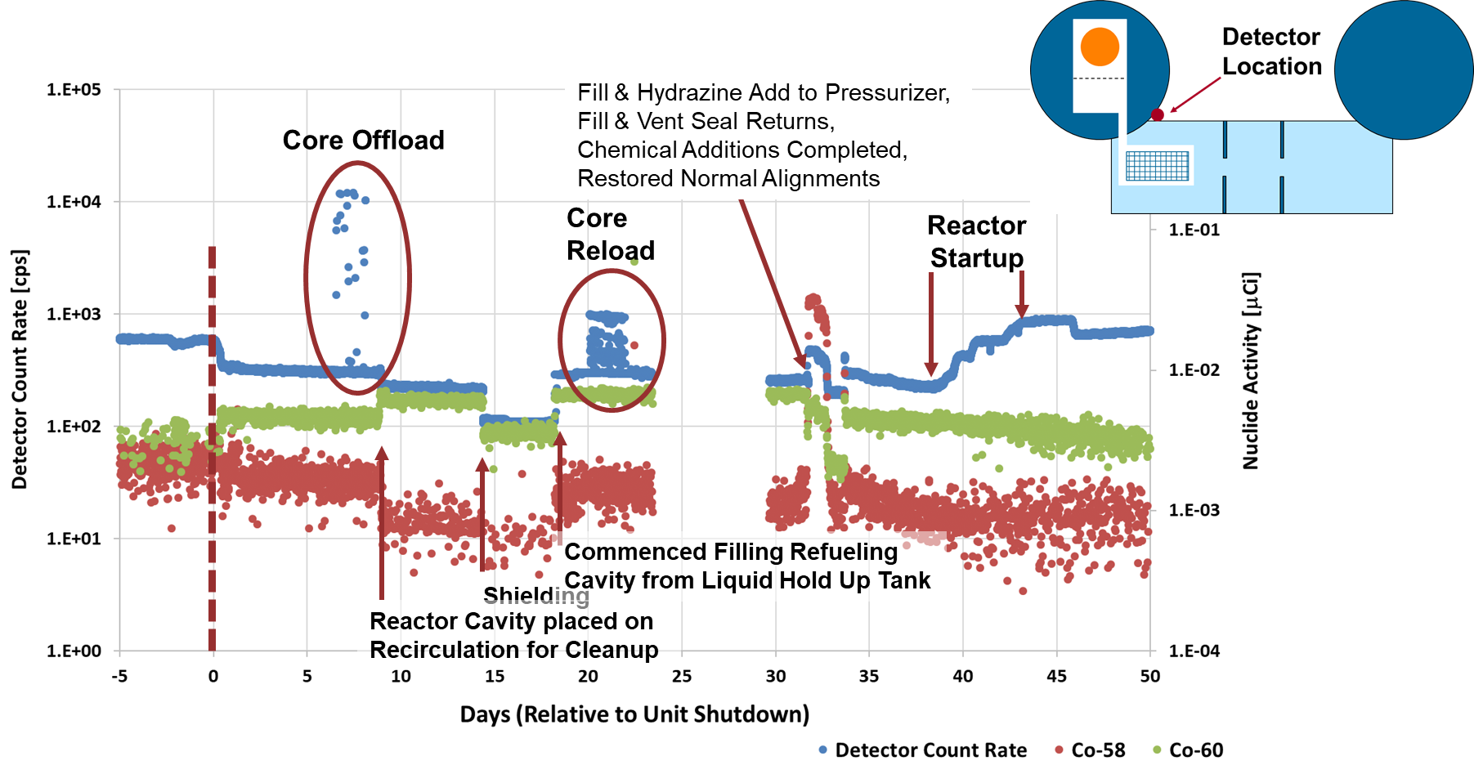
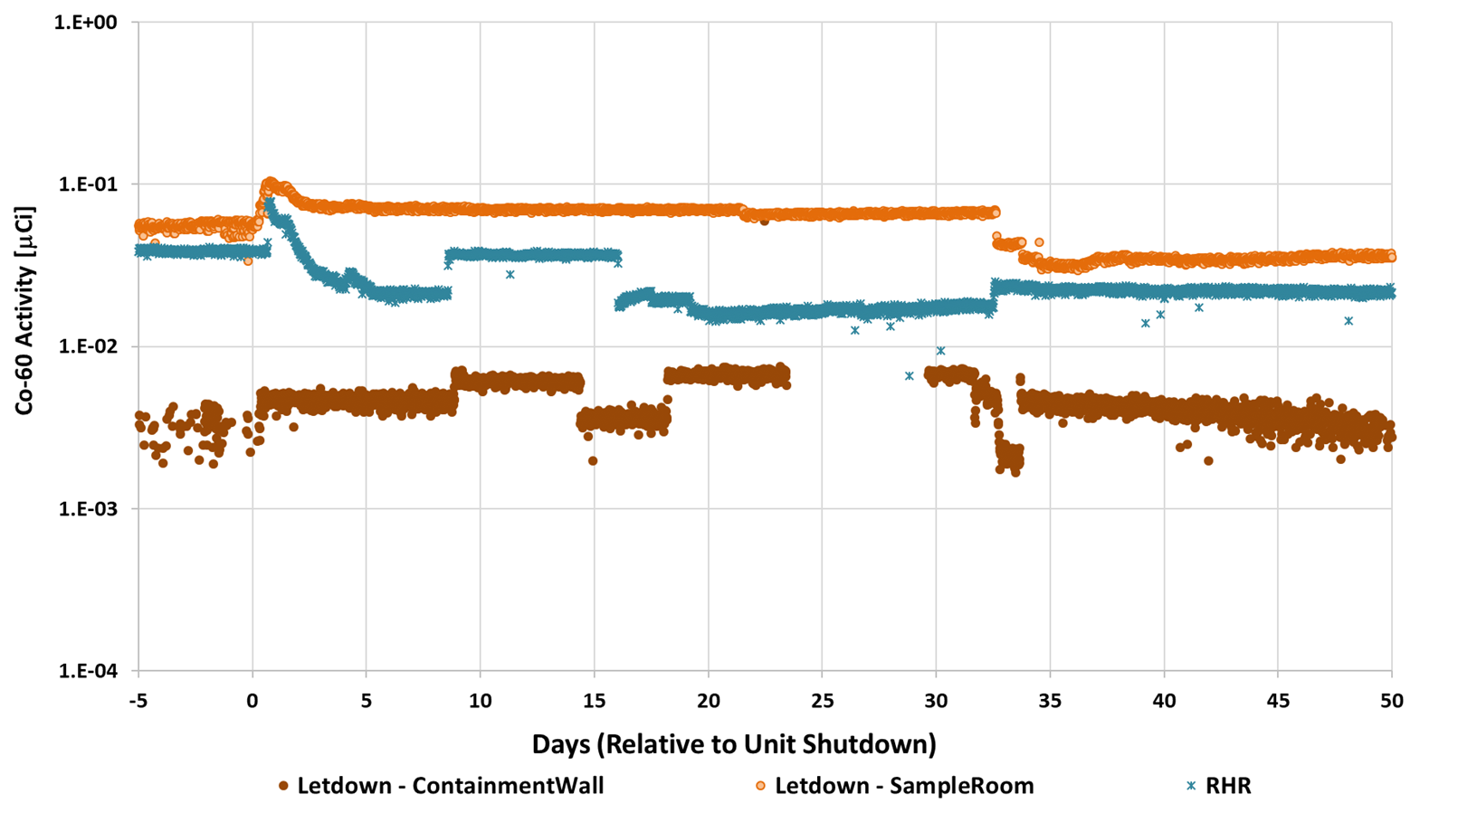
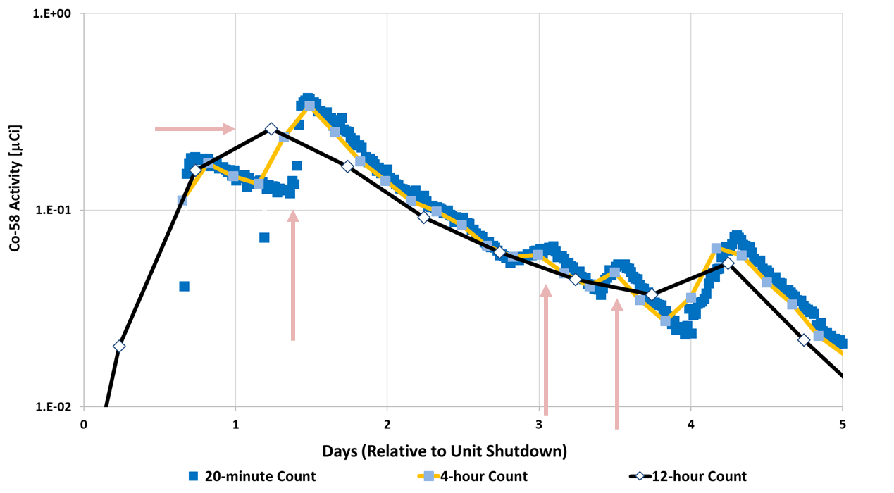
CZT and Operational Data
Operational actions cause changes in radiological conditions
  Dose rates may not reflect individual nuclide behavior
  Nuclide behave differently in different primary circuit locations/systems
Measurement frequency
may matter
  Needs to be tailored to
  monitoring/trending purpose
  Parallel analysis workflows support
  this need
Notes:
Makes sure to mention that sometimes dose rate changes may be impacted by other activities rather than changes in nuclide activities

Slide 9
Gamma Spectrometry Systems
HPGe Based
Thank you to the HPGe Team for their support.
Leah Whiteker, Monticello, for continued operating support and the successful implementation of the skid.
Monticello team for their efforts in overcoming the installation hurdles
Frazier Bronson, Mirion, for his continued support and effort for the data analysis and review
Richard Kohlmann, RSI, for the installation, startup, and ongoing maintenance efforts

Slide 10
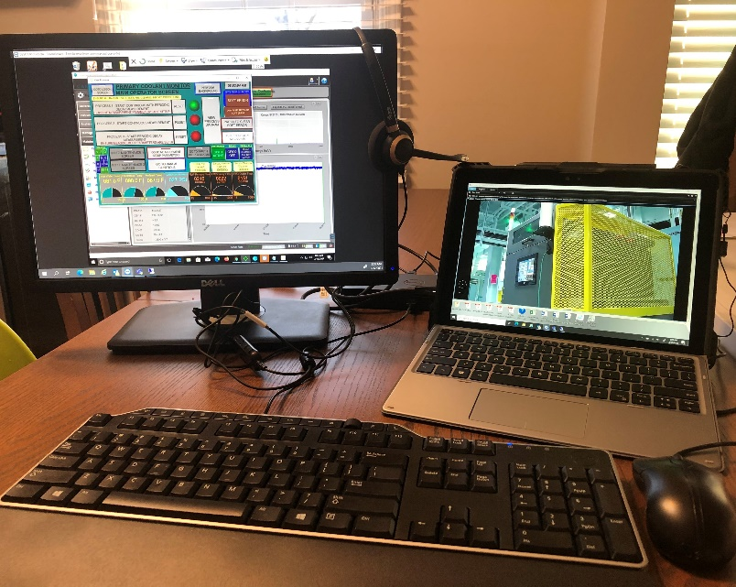
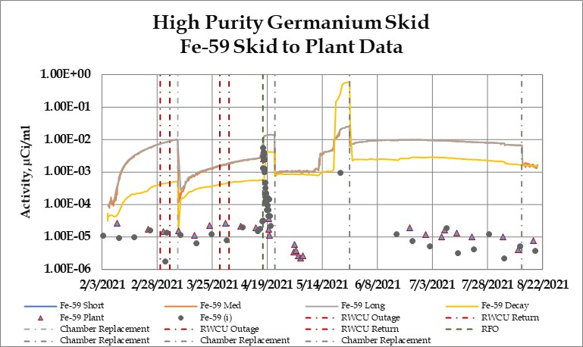
Radiation Field Real-time Isotopic Gamma Monitoring Demo
High Purity Germanium Skid
Skid Performance Observations / Takeaway (DRAFT)
  High Reliability - some initial setup challenges, but after initial setup, minimal operator actions are required.
    Operating since February 2021 with demonstration ended the week of August 23, 2021.
  Flushing, background, and other staff operations were performed remotely including the ability for the vendor to access remotely.
  Radionuclide Behaviors
    All data is preliminary and should only be considered as such!
    Several of the soluble radionuclides are showing within a factor of 10 of plant data.
    Insoluble species are challenging
  Plant transients are clearly captured

Slide 11
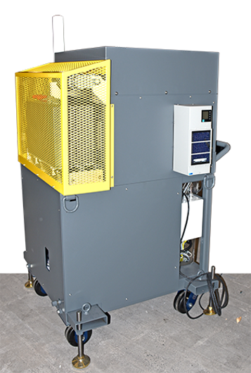
Radiation Field Real-time Isotopic Gamma Monitoring Demo
High Purity Germanium Skid
Feasibility and Functionality Evaluation
  Equipment reliability – can the system operate with minimal hands-on operations
  Minimization of staff resources - the ability to use online sampling to address plant gamma spectroscopy analysis (e.g., backshifts)
  Identification of plant transients to support SMART Chemistry fingerprint logic and ongoing efforts
  Evaluation of the ability to collect and analyze an increased number of samples capturing plant events
Monticello Nuclear Power station
  Special thank you for all of the support
Notes:
EPRI and MIRION partnered together to design the system

Slide 12
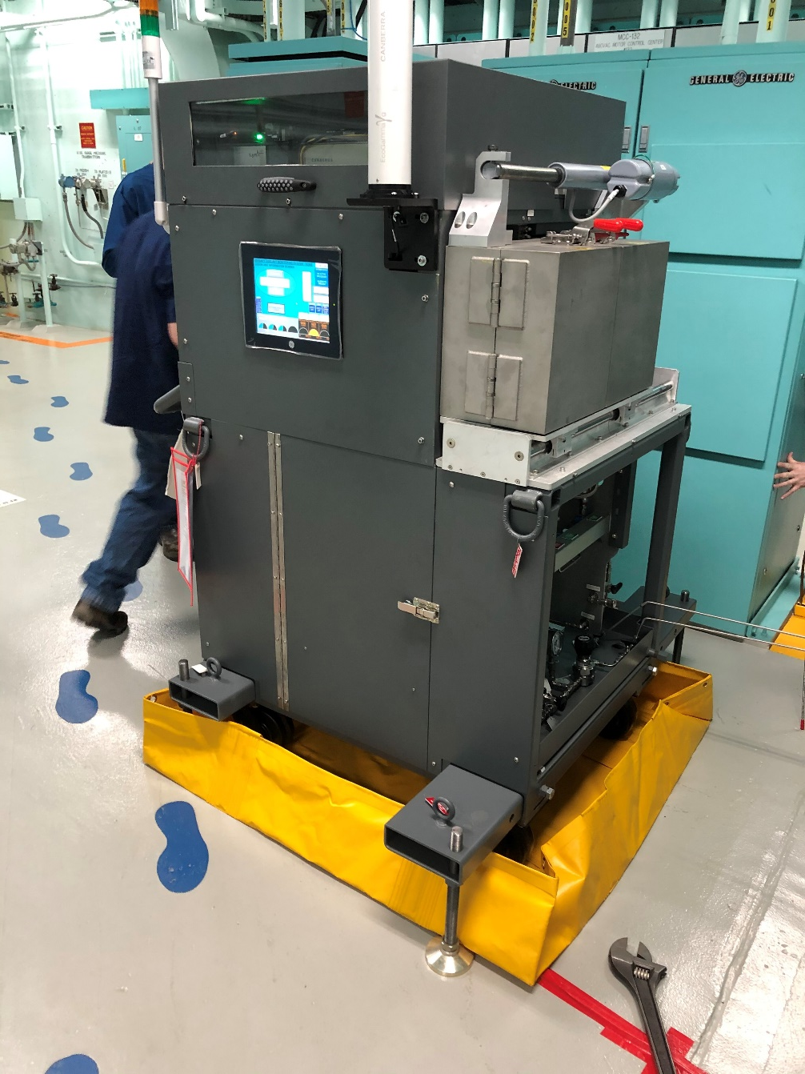
Inline Coolant Isotopic Gamma Monitoring
Skid Overview
Automated/PLC controlled – decay sample on demand
Sample chambers move on sliding track to position in front of detector
Piping, valving, flow and temperature sensors will be located below detector
Sample chambers
  Shielding and each chamber can be connected to a distributing piping (Swagelok quick-disconnect fittings with integral shutoffs)
  Replaceable if contamination buildup is noted.
  Flow path & mechanisms enable draining, flushing, and background analysis
  “In flow path” decay line can be added as needed
System will be contained in water-tight catch pan with leak sensor and shutoff valves
Flow sensor will verify flow in the piping and generate appropriate alerts

Slide 13
Inline Coolant Isotopic Gamma Monitoring
Base Gamma Spectrometer Unit
Overview
Broad-energy HPGe detector to capture standard gamma energies
Very high reliability electric cooler for the detector
ISOCS Detector Characterization: this allows ISOCS mathematical efficiency calibrations to be performed, which is a fully recognized calibration method per US NRC Regulatory Guide 1.21
Check source (natural thorium) with manual insertion mechanism – automation possible
Overview (cont.)
Data Acquisition platform to contain
  Controller for the electric cooler
  Lynx Multi Channel Analyzer and Data Analyst Laptop local PC, on a folding shelf, used as needed for setup and local data viewing with Network hub for Ethernet or Wi-Fi remote communications
  EcoGamma dose-rate sensor
  TouchPanel for PLC control and readout
All results sent to data base.
  Nuclide activity for various time regions can be viewed by authorized users wherever there is a data connection
Standard Gamma Spectrometry Data Acquisition Software & Data Management

Slide 14
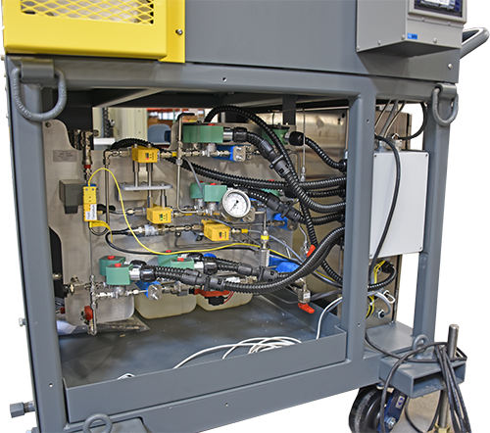
Inline Coolant Isotopic Gamma Monitoring
Unit Footprint – Floor Loading – Weight – Shielding Optimization
Unit Footprint [inch x inch] | Floor Loading [pound per square foot] | Unit Weight [lbs] | External Shielding Thickness [inch lead]
30 x 36 | 213 | 1600 | 4
30 x 36 | 160 | 1200 | 3
30 x 36 | 120 | 900 | 2
A support stand is complete with lifting hooks, forklift pockets, wheels, stabilization pads, and anchoring options as required per site seismic evaluation.
Shields around the back and sides of the detector to reduce potential interference from general area radiation field. Shielding can be customized to balance floor loading
Demonstration Dose Rate Lesson Learned:
  The skid dose rates were maintained low UNTIL the startup activity transient.
  A 600 mrem/hour hot spot was located on the inlet line. Can be addressed in future work
Optimizations Option Enable Achieving MDAs within Weight Constraints
Notes:
Additional Shielding Details:
– Disadvantage, shielding changes may impact MDA
Proposed shielding is 4” thick lead with a copper inner liner. This liner absorbs the lead X-rays that are in the 90 keV range, so they do not interfere with the important Xe-133 gammas at 80 keV. A shielded segment containing two sample chambers slides horizontally exposing each sample to the detector, one at a time. The sample chambers can be between about 3 to 400 cc, allowing sensitivity adjustment depending upon normal range of coolant activity and programmed decay time. The sample chambers can be easily replaced if they become contaminated.
Perspective Example: Portable outage unit completely shielded with 4-in lead equivalent in an ambient field of 45 mR/hr when directed toward and in close proximity of a primary coolant piping survey location has a dead time of 0.4%. Source: RSI measurements at David Besse.
\

Slide 15
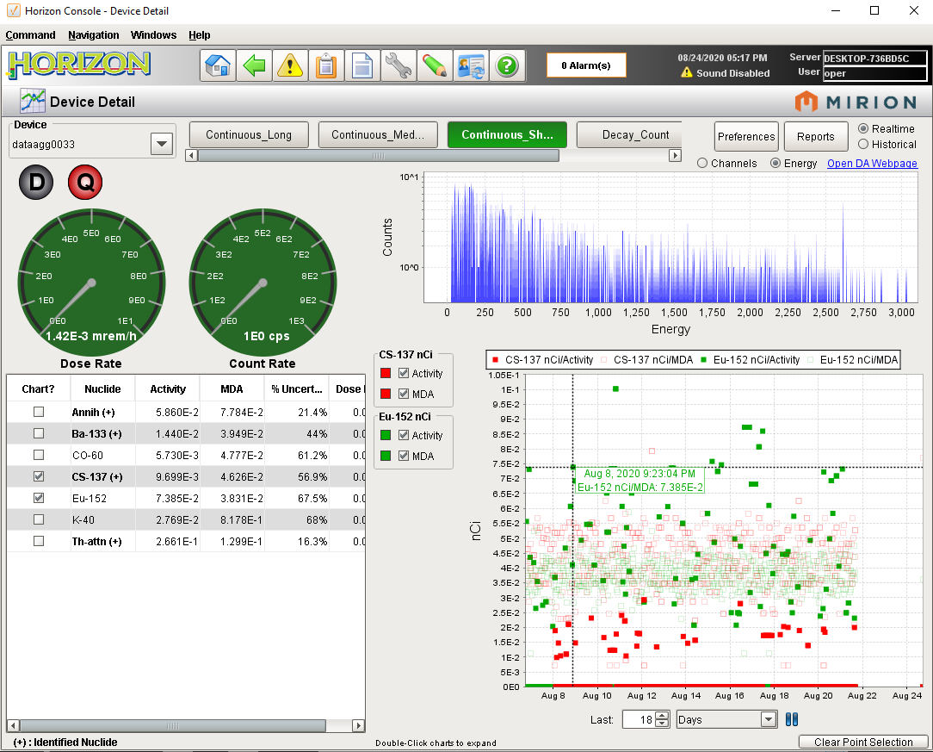
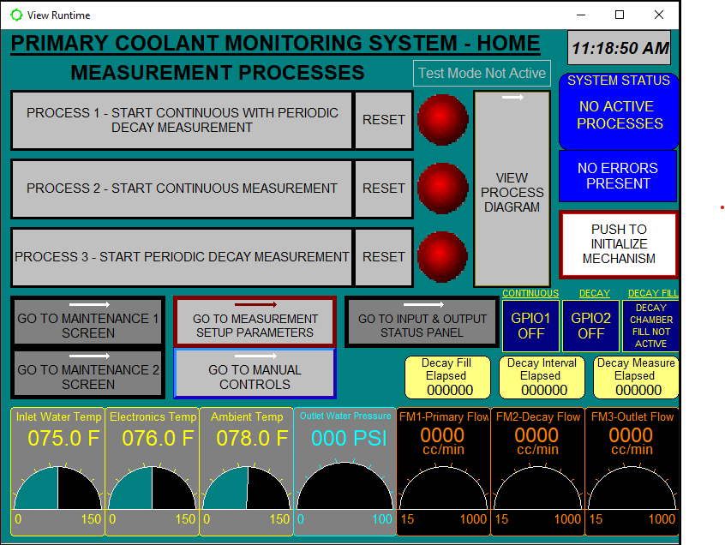
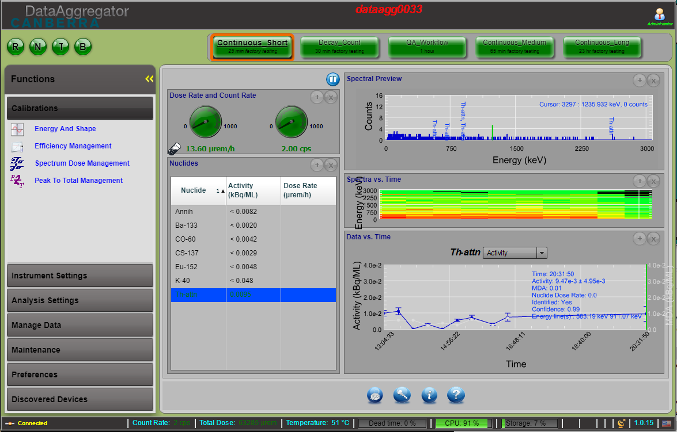
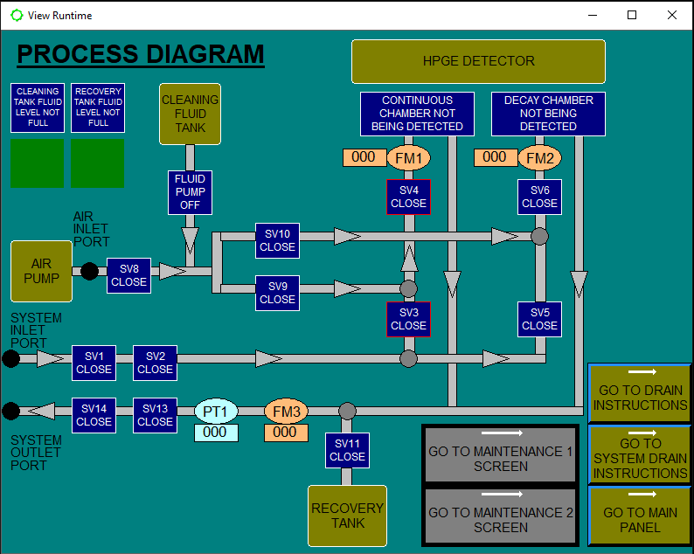
Graphical Displays
Horizon, Data Analyst, and PLC
Horizon
Data Analyst Screen below
  From Remote PC or Laptop
Programmable Logic Controls

Slide 16
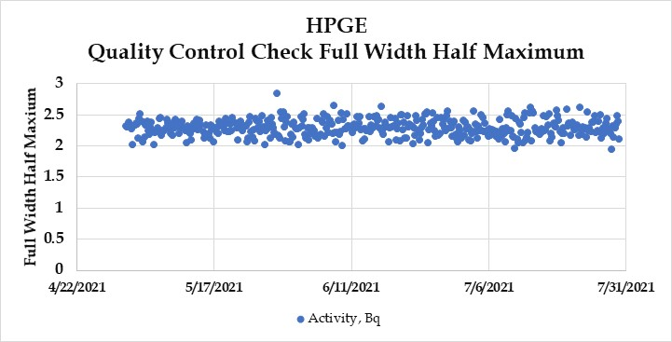
High Purity Germanium Skid
Quality Check Review
Instrument quality controls
  The skid uses a commercially available welding rod with natural thorium filtered to remove low energy lines for the check source
  Source activity continuously acquired and analyzed every 4 hours for Activity [efficiency], Peak Centroid [gain], and FWHM [spectral quality]
  Quality control checks are consistent and within a simple 2-sigma calculation
  Mirion staff noted that a stable Activity value indicates the gain and efficiency are stable
Instrument flow and other diagnostics
  This original flow control valve was supplemented with a finer control valve allowing plant staff better flow control adjustment. Flow is now being maintained as expected.
    The red spikes on the lower graph indicate decay chamber flow initiation and chamber fill

Slide 17
High Purity Germanium Skid
Flush Observations (Recovery)
Flushing Operations
  Flushing operations are part of the background process.
  Monticello staff with Mirion worked to optimize the flush times and attempted to optimize the required flushing based on the radionuclide behaviors.
  The time for flushing and background is ~4-hours
Post-Flushing Observations
  Mn-56 and Co-60 activities increase above the prior to activity.
  Co-58 is an example of a short or quicker recovery back to the activity prior to the flush
  As-76, Zn-65, and Zn-69m are examples that take a longer period to reach the activity prior to flush operations (bottom graph)

Slide 18
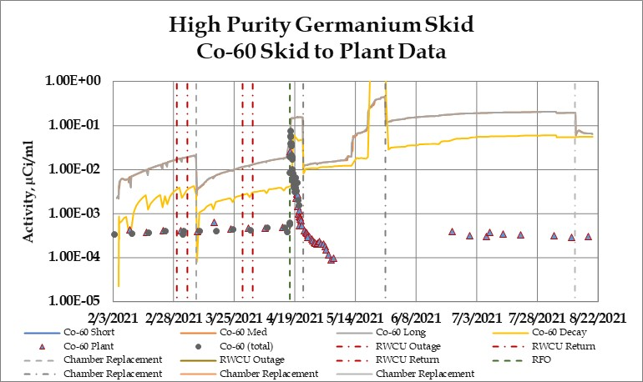
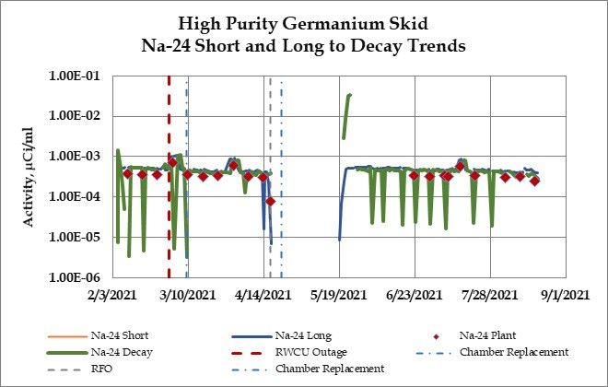
High Purity Germanium Skid – Challenges
Background Growth
  The demonstration evaluated 5 different chamber coating processes to evaluate and attempt to minimize sample chamber contamination.
    These chambers included stabilized chrome, platinum coating, and electropolishing.
Background Observations
  A wide range of reduction in activity is noted when the chamber is flushed with demineralized water.
    The soluble radionuclides show a better flushing result while the activated corrosion products show little change, and some nuclides are completely flushed
    Activity appears to start building quickly on some nuclides and much more slowly on other nuclides.
  The decay chamber does not show the chamber reaching an equilibrium.

Slide 19
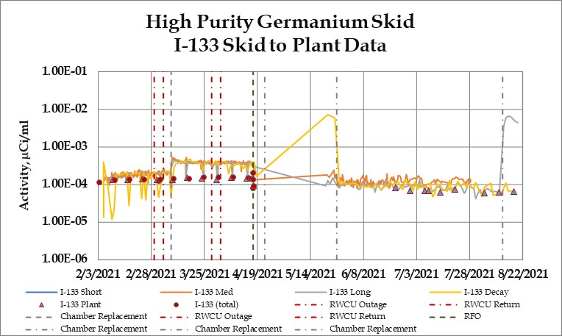
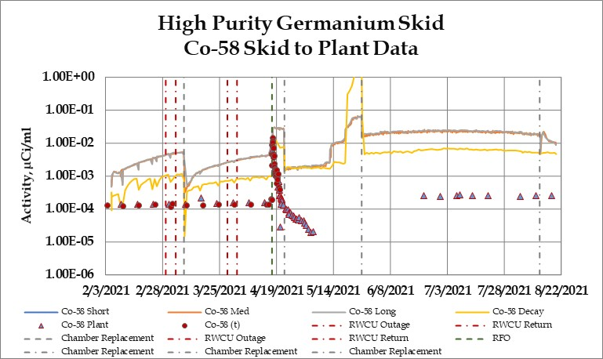
High Purity Germanium Skid – Data
The HPGe system is setup with 2 pathways and for multiple counts.
  Continuous analysis
    Short-, medium-, and long-counts are performed
  Decay analysis: once a day flow is routed to the decay chamber and analyzed after decay
Data Overview:
  Soluble data, in many cases, but not all cases, was consistent with plant data
  Insoluble data was not consistent and
  Data evaluation(s) is in progress.

Slide 20
High Purity Germanium Skid – Plant Transient Observation
Reactor Water Cleanup Outage
  On March 1, 2021 09:30 am reactor water cleanup (RWCU) was bypassed for demineralizer backflush and regeneration
  Returned to service on March 5, 2021 18:07
Observations
  Na-24, Sr-91, Y-91m, Xe-135m, and Ba-139 increased during the event.
  N-13, O-19, Mg-27, Mn-56, and Ba-42 reductions were observed
  This data provides input in the impact of RWCU cleanup changes is part of the larger Smart Chemistry Project fingerprint logic

Slide 21
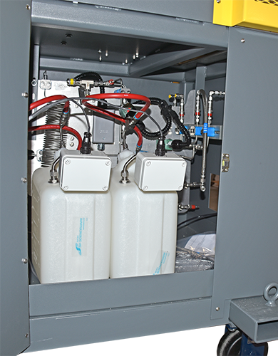
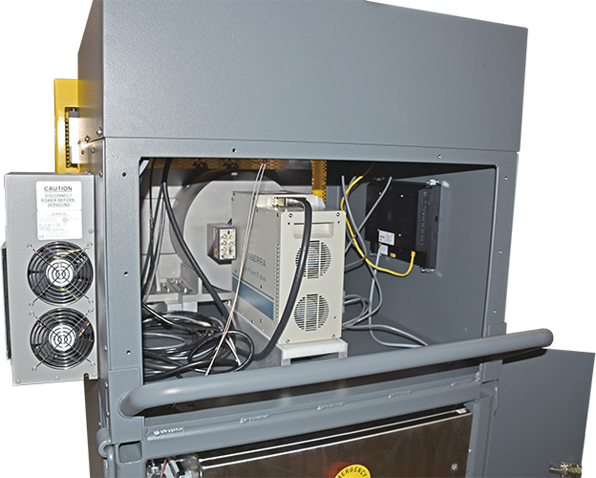
High Purity Germanium Skid
Next Steps
Skid shipment
  The skid was removed, drained, and placed in a DOT shipping container
  Low radioactive waste shipment is being planned for October
Skid plan
  Test the onboard flushing system and if possible, evaluate a mild decontamination solution impact.
  Remove components that cannot be decontaminated (e.g., valve gallery, etc.)
  Release components, where possible
Report
  Complete the data evaluation and document results in a report
Cooler

Slide 22
HPGe and SMART Chemistry
Connect the Data
SMART Chemistry
Ability to link across the plant site
Control Room Operations
Continuous Monitoring Skids
Automated diagnostics and trending
Cross-linking to Plant Programs (Condition Based Monitoring)
Augmented Limits
Augmented intelligence
Laboratory Operations
In the field vs. automated data processing
Apply real-time sampling of all essential chemistry parameters
Apply automated diagnostics and trending
  Enhanced monitoring and early warnings
  Application of automated chemistry controls (chemical adds, systems IS/OS, etc.)
Application of Augmented Limits
  Account for value of sampling, diagnostics, and control technologies and life expectancy
  Risk-informed, where possible
The CORRECT data, monitoring, and evaluations with the RIGHT responses can lead to:
Improvements in safety margin and reduced operating cost
Notes:
A possible scenario where diagnostics software coupled with online monitoring may be able to capture fuel leakage events where maybe a low-power rod pops and releases a small and short-term amount of fission products; something that may not even be seen with daily sampling and a new tech may not even know how to diagnose the issue even if the release is captured with the sample.

Slide 23
Data Transfer and Analytics
Understand the Full System
Plant Parameters
– Power, SGBD flow, and chemistry instruments
– Model development accounting for plant transients
Modeling and Scenarios
– Chemistry transients induced by plant transient
– Reactor power, SGBD flow, steam and feedwater flow oscillations
Chemistry Changes
– Multiple parameters
– Model development accounting for chemistry transients
Whole plant approach – Application of the plant-specific heat balance, instrumentation, and chemistry controls provides for the ability to sort out chemical transients with plant operating transients.
Limitations – the details of the plant specific model, the instruments, and delay times with instruments, etc.
Notes:
23

Slide 24

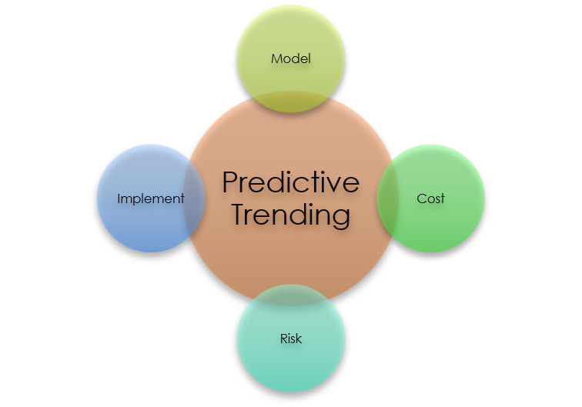
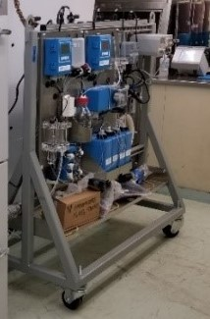
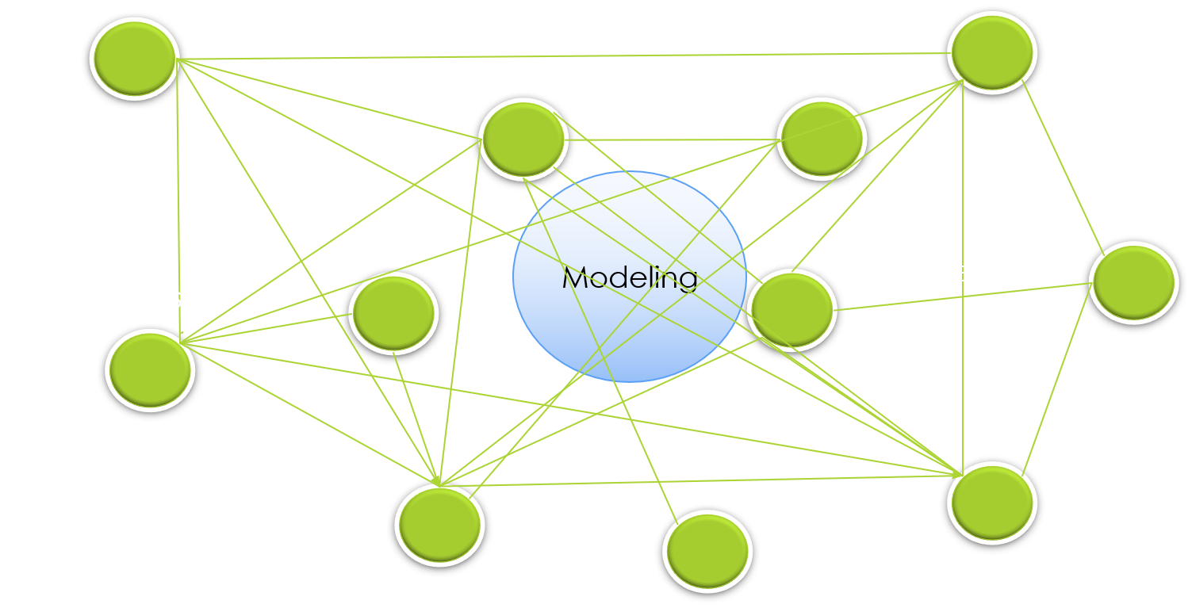
Putting It All Together
Data
Monitoring
Security
Analysis
Predictive
Trending
User Friendly
Plant Data
LDMS
Plant Components
Data Analysis
Data Historian
Skid
Looking ahead
Modeling

